Slide 2
Online Tutorial : Number Two:
Session Three: Logic
Propositions, Symbolic Statements and Truth Tables
Conditional Connectives
Laws of Logic
Logic Gates

Slide 3
Logic: Symbolic Statements and Truth Tables
Propositions
Tautologies and Contradictions
Negation of a proposition
NOT
Compound statements
AND
OR
XOR
Truth Tables

Slide 4
Logic: The Conditional Connectives
The Conditional Connectives
The Conditional Connectives are
If
Only If / Implies (p → q)
If and Only If (p ↔ q)
Truth Tables
The Contra-Positive (approach using truth tables)

Slide 5
Logic: Symbolic Statements and Truth Tables
(2008 Q3a)
Let p and q be the following propositions about an object
p: “ this objects is a triangle”
q: “ this object is blue”
Express each of the following compound propositions symbolically by using p, q and appropriate logic symbols
This object is a blue triangle
If this object is blue, then it is a triangle
This object is not blue, but it is a triangle.

Slide 6
Logic: The Contrapositive
(From previous question,2008 Question 3)
Write in words the contrapositive of the statement given symbolically as “q → p” .
(i.e. If the object is blue then it is a triangle.)
¬p: “ this objects is not a triangle”
¬q: “ this object is not blue”

Slide 7
Logic: The Laws of Logic
The Laws of Logic
The Commutative Laws
The Associative Laws
Distributive Laws
De Morgan’s Laws
Identity Laws
Asborption and Complement Laws

Slide 8
Logic: The Laws of Logic : Membership Tables
p | q | ¬p | ¬q | p∧q (“AND”) | p∨ q (“OR”) | p → q | p ↔ q | p ⊕q (“XOR”)
0 | 0
0 | 1
1 | 0
1 | 1

Slide 9
Logic: The Laws of Logic : Membership Tables
p | q | ¬p | ¬q | p∧q (“AND”) | p∨ q (“OR”) | p → q | p ↔ q | p ⊕q
0 | 0 | 1 | 1 | 0 | 0 | 1 | 1 | 0
0 | 1 | 1 | 0 | 0 | 1 | 1 | 0 | 1
1 | 0 | 0 | 1 | 0 | 1 | 0 | 0 | 1
1 | 1 | 0 | 0 | 1 | 1 | 1 | 1 | 0

Slide 10
Logic: The Laws of Logic
(2012 Zone B Question 2 c) Use Truth Tables to prove that:
(p∧q) ∨ (¬p ∧ ¬q) ≡ p ↔ q
p | q | p∧q | ¬p | ¬q | (¬p ∧ ¬q) | (p∧q) ∨ (¬p ∧ ¬q) | p ↔ q
0 | 0 |  | 1 | 1 |  |  | 1
0 | 1 |  | 1 | 0 |  |  | 0
1 | 0 |  | 0 | 1 |  |  | 0
1 | 1 |  | 0 | 0 |  |  | 1

Slide 11
Logic: The Laws of Logic (Answer)
(2012 Zone B Question 2 c) Use Truth Tables to prove that:
(p∧q) ∨ (¬p ∧ ¬q) ≡ p ↔ q
p | q | p∧q | ¬p | ¬q | (¬p ∧ ¬q) | (p∧q) ∨ (¬p ∧ ¬q) | p ↔ q
0 | 0 | 0 | 1 | 1 | 1 | 1 | 1
0 | 1 | 0 | 1 | 0 | 0 | 0 | 0
1 | 0 | 0 | 0 | 1 | 0 | 0 | 0
1 | 1 | 1 | 0 | 0 | 0 | 1 | 1

Slide 12
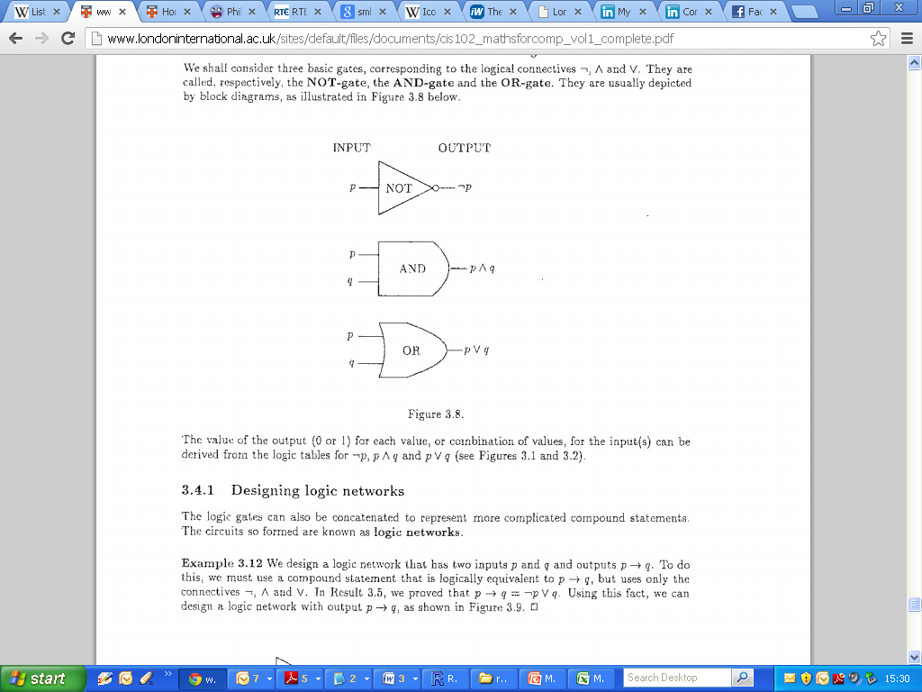
Logic: Logic Gates
Designing Logic Gates
Output of a given Network

Slide 13
Logic: Logic Gates
(2008 Q3b)
Construct a logic network that accepts as inputs p and q, which may independently have value 0 or 1, and give as final output ¬(p ∧ ¬q) .
Show that this expression is equivalent to p → q. (i.e. using truth tables)

Slide 14
Logic: Logic Gates

Slide 15
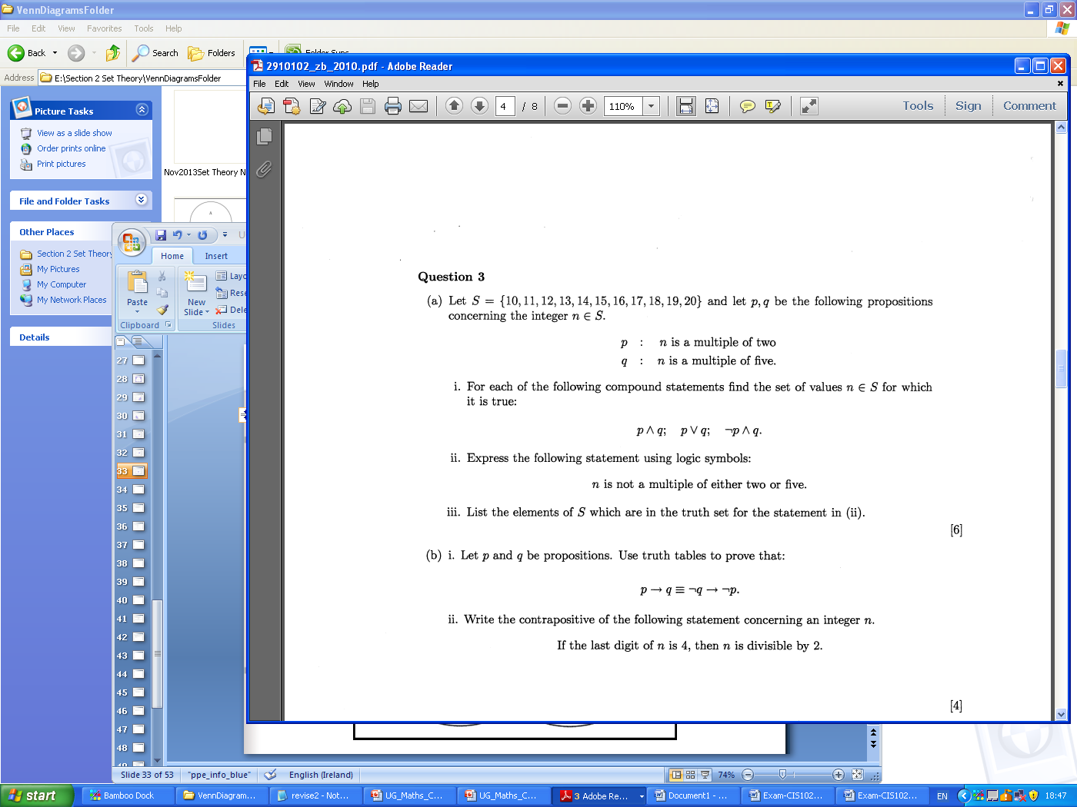
2010

Slide 16
2010

Slide 17
2010 - Blank

Slide 18
2010 - Blank

Slide 19
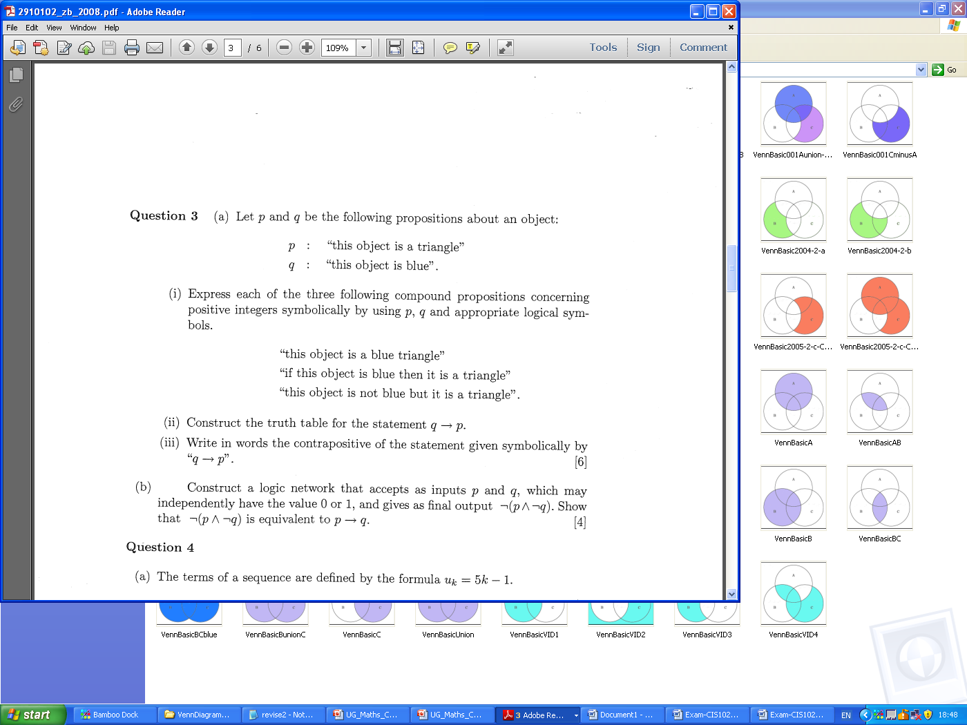
2008

Slide 20
2008 - Blank

Slide 21
2008

Slide 22
2008 - Blank

Slide 23
2008 - Blank

Slide 24
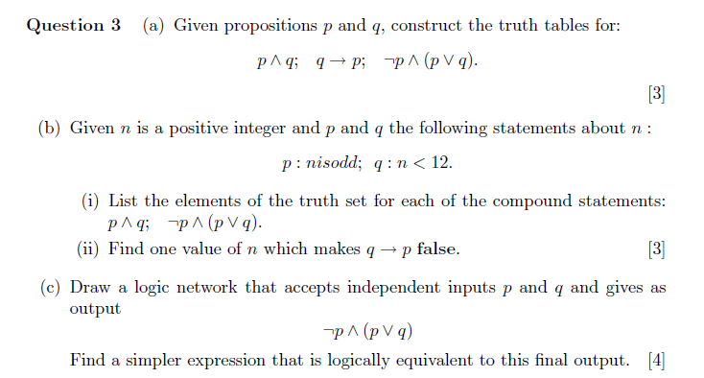
2005

Slide 25
2005 - Blank

Slide 26
2005 - Blank

Slide 27
2005 - Blank

Slide 28
2005 - Blank

